Slide 1
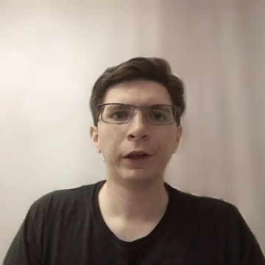
The Role of Abstract Representations and Observed Preferences in the Ordering of Binomials in Large Language Models
Zachary Nicholas Houghton, Kenji Sagae, and Emily Morgan
University of California, Davis
Notes:
Hello, my name is Zachary Houghton and I will be presenting work in collaboration with Kenji Sagae and Emily Morgan on the role of abstract representations and observed preferences in the ordering of binomials in large language models, or LLMs.

Slide 2
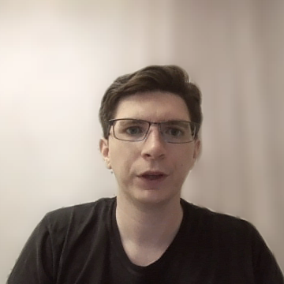
Do LLMs Learn Abstract Representations?
LLMs are capable of producing natural, fluent language.
How are they able to do this?
Copying?
Learning abstract representations?
Combination of both?
Notes:
In the last few years there have been rapid advancements in the abilities of LLMs, culminating in models that are able to produce natural, fluent language, that is often times indiscernible from human text.
How do they do this? Are they simply copying from their massive training corpora, or are they learning abstract representations? Or some combination of the two?

Slide 3
LLMs Copy
LLMs show evidence of copying a lot from their training.
BERT struggles to determine the plurality of novel words (Haley, 2020).
GPT-2 copies extensively (McCoy et al., 2023)
Bert relies on memorization when producing the correct tense for a word (Li and Wisniewski, 2021).

Slide 4
LLMs Learn
LLMs show evidence of learning abstract representations
GPT-2 (despite copying extensively) produces novel words and novel syntactic structures (McCoy et al., 2023).
BERT uses abstract knowledge to predict subject-verb and object-past participle agreements in French (Lasri et al., 2022).
Language models also are able to learn abstract representations for the dative alternation (Yao et al., 2025) and Adjective Numeral Noun constructions (AANN, e.g., a beautiful five days; Misra and Mahowald, 2024).

Slide 5
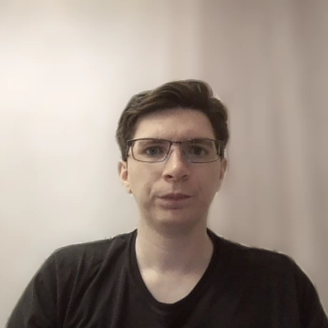
Human Ordering Preferences
To examine LLMs’ learning, we turn to the human psycholinguistics literature.
Humans learn ordering preferences (Morgan & Levy, 2015; 2026; 2024) for binomials (e.g., bread and butter preferred over butter and bread).
Driven partly by experience (i.e., frequency) and partly by abstract preferences (e.g., short words before long words).
Notes:
In order to examine this, we turn to the human Psycholinguistics literature.
The human psycholinguistics literature has demonstrated that humans learn ordering preferences for binomials, preferring bread and butter over butter and bread for example.
These ordering preferences are driven partly by experience, such as reproducing bread and butter simply because it is the more frequent ordering, and partly by abstract preferences, such as a preference for short words before long words.

Slide 6
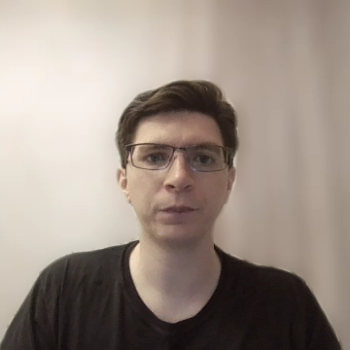
Present Study
Are LLMs’ ordering preferences driven by:
Abstract preferences?
Experience (frequency)?
Both?
Notes:
In the present study, we examine whether LLM ordering preferences are driven by abstract preferences, experience, or both.

Slide 7
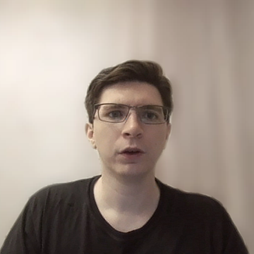
Dataset
594 binomials ranging in frequency from low-frequency to high-frequency.
Coded for:
Abstract preferences (calculated from Morgan & Levy, 2015).
Observed preferences (proportion of occurrences that are in alphabetical ordering).
Frequency (total number of occurrences in either ordering).
Notes:
In order to examine this, we used a dataset from Morgan & Levy (2015) that contains 594 binomials ranging from low-frequency to high-frequency.
These binomials are coded for abstract preferences, which are calculated using a logistic model that combines various constraints that are known to affect human ordering preferences. They are also coded for observed preferences which are the proportion of occurrences that are in alphabetical ordering, where alphabetical ordering is used as a neutral reference order, and they are coded for frequency which is the total number of times the binomial occurs in either order.

Slide 8
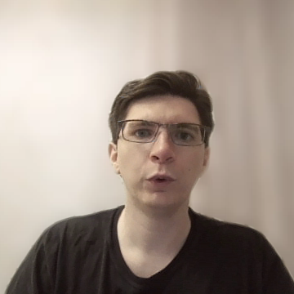
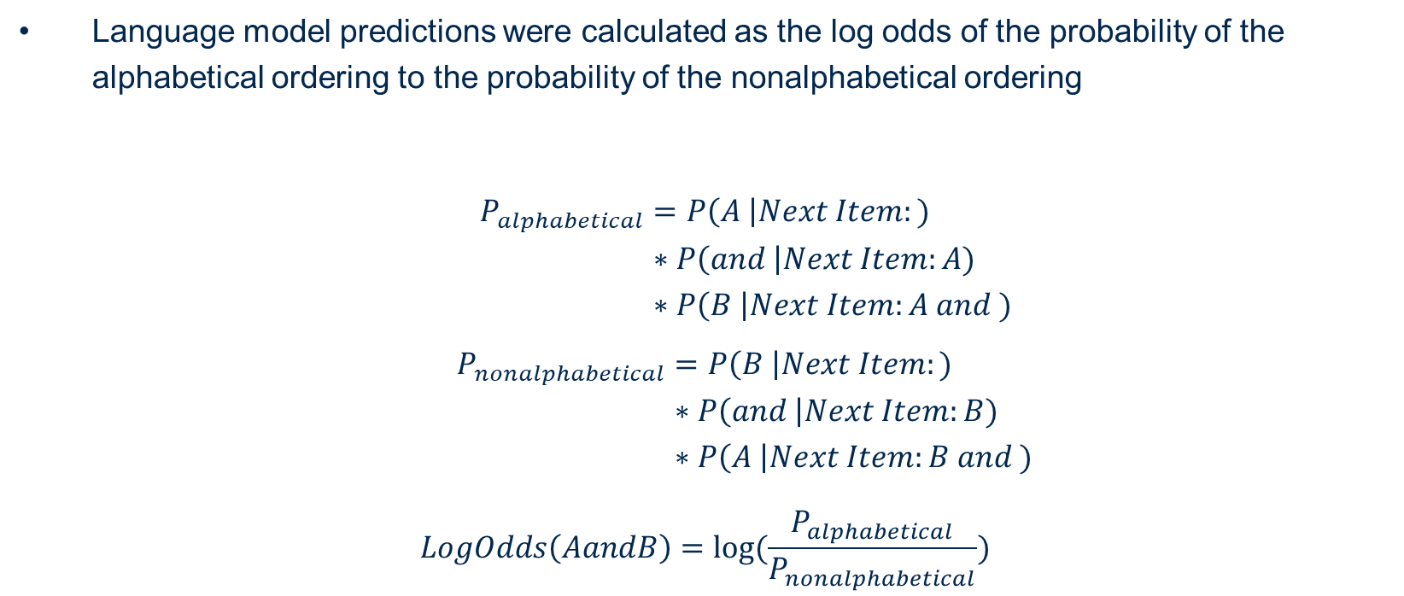
LLM Ordering Preferences
Language model predictions were calculated as the log odds of the probability of the alphabetical ordering to the probability of the nonalphabetical ordering
$$P_{alphabetical}=P\left(A \right|Next Item:) \\ ∗P\left(and \right|Next Item:A) \\ ∗P\left(B \right|Next Item:A and )$$
$$P_{nonalphabetical}=P\left(B \right|Next Item:) \\ ∗P\left(and \right|Next Item:B) \\ ∗P\left(A \right|Next Item:B and )$$
$$LogOdds\left(AandB\right)=log⁡(\frac{P_{alphabetical}}{P_{nonalphabetical}})$$
Notes:
We calculated the LLMs predictions as the log odds of the probability of the alphabetical ordering to the probability of the nonalphabetical ordering.
The probability of the alphabetical ordering is the product of the probability of each word conditioned on each of the previous words.
We used a prefix, Next Item, to calculate these probabilities because LLMs predict the probability of the next word. As such, if we included only the binomial, the LLM would not predict the first word in the binomial.

Slide 9
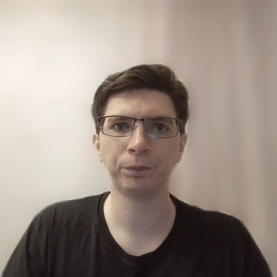
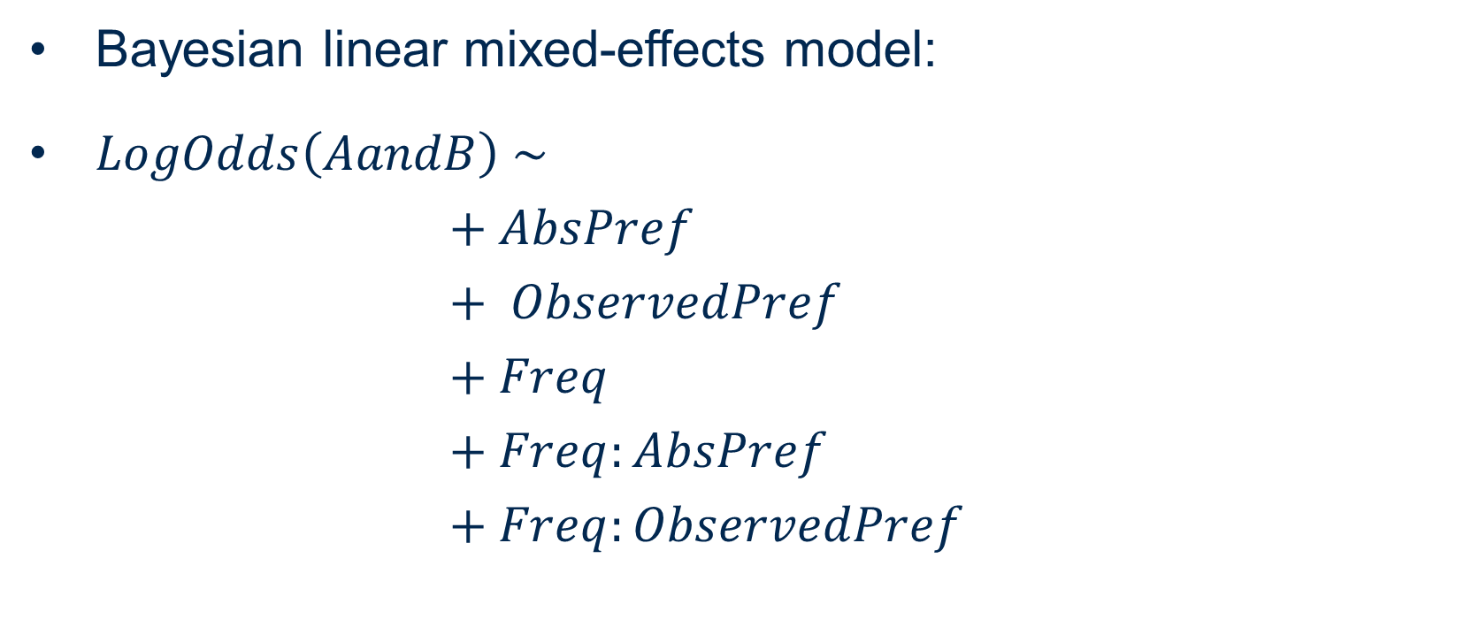
Analysis
Bayesian linear mixed-effects model:
$LogOdds\left(AandB\right) \sim$ $+ AbsPref$ $+ ObservedPref$ $+ Freq$ $+ Freq:AbsPref$ $+ Freq:ObservedPref$
Notes:
In order to analyze our data, we used a Bayesian linear mixed-effects model, with fixed-effects for abstract preferences, observed preferences, frequency, and the interaction between frequency and abstract preferences, and frequency and observed preferences.

Slide 10
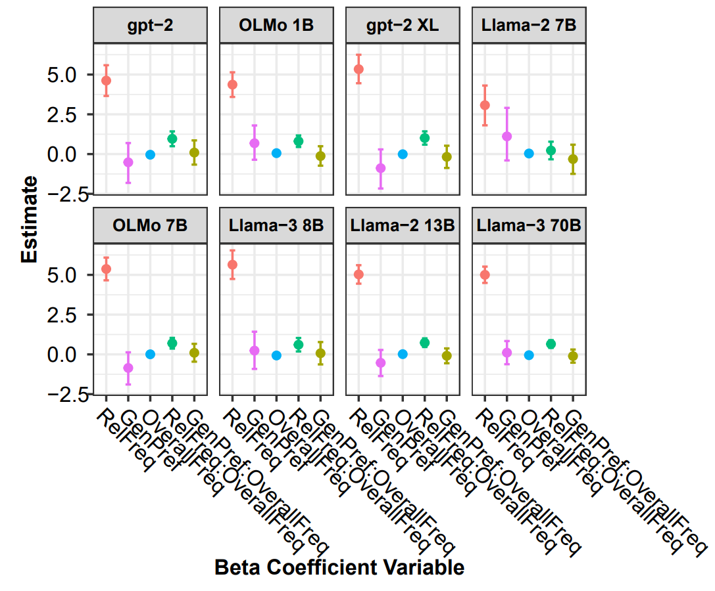
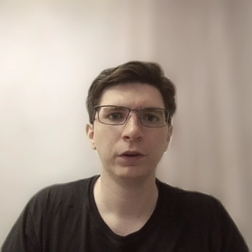
Results
LLMs across the board rely on experience as opposed to abstract preferences.
Rely on experience even more for high-frequency items.
Notes:
We analyzed data from 8 LLMs: GPT-2, OLMo-1B, gpt-2 XL, Llama-2 7B, OLMo-7B, Llama-3 8B, Llama-2 13B, and Llama-3 70B.
The figure on the right shows each of the coefficient estimates for each LLM. The x-axis is the beta coefficient and the y-axis is the coefficient estimate.
The coefficient of interest is the purple one representing abstract preference. Notice that this estimate crosses zero for every single language model.
These results suggest that LLMs across the board rely on experience as opposed to abstract preferences.
These results also suggest that LLMs rely on experience even more for high-frequency items, as indicated by the positive interaction effect between observed preferences and frequency.

Slide 11
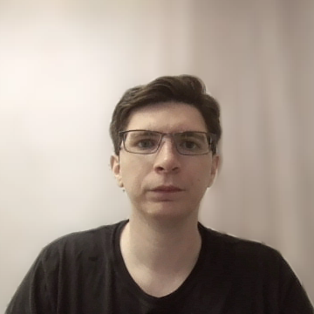
Summary
LLMs seem to rely on experience when ordering binomials.
Caveats
All LLMs likely have had some experience with our items
However humans show abstract preferences for binomials even those that they have experienced a large number of times (Morgan & Levy, 2024).
Notes:
In summary, LLMs rely on experience when ordering binomials.
However, it is important to point out a few caveats.
First, each of the LLMs likely have had some experience with each of the binomials, even the low-frequency binomials.
However, there is evidence that humans show abstract preferences for binomials, even those that they have experienced a large number of times.

Slide 12
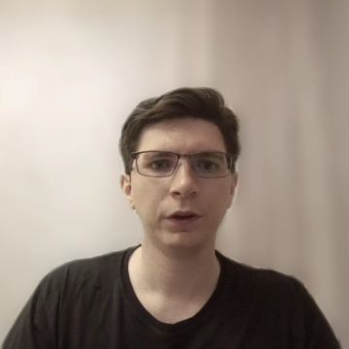
References
Haley, C. (2020, November). This is a BERT. Now there are several of them. Can they generalize to novel words?. In Proceedings of the Third BlackboxNLP Workshop on Analyzing and Interpreting Neural Networks for NLP (pp. 333-341).
Lasri, K., Seminck, O., Lenci, A., & Poibeau, T. (2022). Subject verb agreement error patterns in meaningless sentences: Humans vs. BERT. arXiv preprint arXiv:2209.10538.
Li, B., & Wisniewski, G. (2021, April). Are neural networks extracting linguistic properties or memorizing training data? an observation with a multilingual probe for predicting tense. In EACL 2021.
McCoy, R. T., Smolensky, P., Linzen, T., Gao, J., & Celikyilmaz, A. (2023). How much do language models copy from their training data? evaluating linguistic novelty in text generation using raven. Transactions of the Association for Computational Linguistics, 11, 652-670.
Misra, K., & Mahowald, K. (2024). Language models learn rare phenomena from less rare phenomena: The case of the missing AANNs. arXiv preprint arXiv:2403.19827.
Morgan, E., & Levy, R. (2015). Modeling idiosyncratic preferences: How generative knowledge and expression frequency jointly determine language structure. In Proceedings of the Annual Meeting of the Cognitive Science Society (Vol. 37).
Morgan, E., & Levy, R. (2016). Abstract knowledge versus direct experience in processing of binomial expressions. Cognition, 157, 384-402.
Morgan, E., & Levy, R. (2024). Productive knowledge and item-specific knowledge trade off as a function of frequency in multiword expression processing. Language, 100(4), e195-e224.
Yao, Q., Misra, K., Weissweiler, L., & Mahowald, K. (2025). Both direct and indirect evidence contribute to dative alternation preferences in language models. arXiv preprint arXiv:2503.20850.

